Slide 1
Template Guide
(codelabor-flex-lcds-template)
2009. 01. 05
CODELABOR
Shin Sang Jae (codelabor@gmail.com)

Slide 2
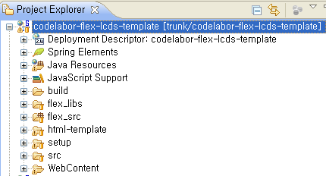
Project Template
Directory Overview
Perspective: Java EE
Java source directory
TestCase output directory
Flex library directory
Flex source directory
Ant build file directory
Web content directory

Slide 3
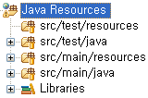
Project Template
Java Source Directory 1/2
Non java source directory for TestCase
Java source directory for TestCase
Non java source directory
Java source directory

Slide 4
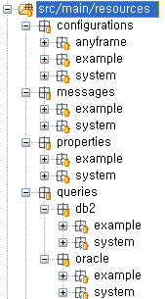
Project Template
Java Source Directory 2/2
Application context directory for anyframe
Application context directory for example
Application context directory for system
Message directory for example
Message directory for system
Queries directory for example (DB2)
Queries directory for system (DB2)
Queries directory for example (Oracle)
Queries directory for system (Oracle)

Slide 5
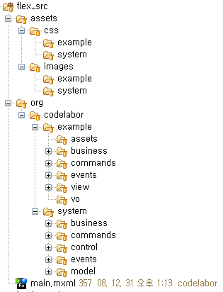
Project Template
Flex Source Directory
Flex css directory
Flex images directory
Service locator, Delegate directory
Commnand directory
Front controller directory
Event directory
Model locator directory

Slide 6
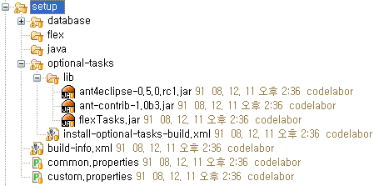
Project Template
Setup Directory 1/2
Ant build file directory for database setup
Ant build file directory for mxmlc (Flex)
Ant build file directory for javac (Java)
Ant build file directory for optional task setup
Ant task jar directory
Ant build file for optional tasks installation
Ant build file for prompt system environment
Ant build file for common configuration
Ant build file for custom configuration

Slide 7
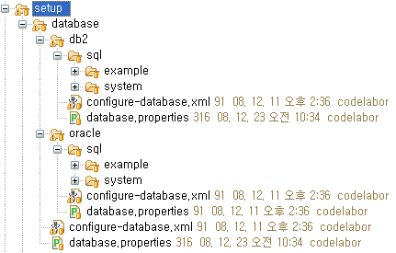
Project Template
Setup Directory 2/2
SQL file directory for example (DB2)
SQL file directory for system (DB2)
Ant build file for database setup (DB2)
Properties file for database setup (DB2)
Ant build file for database setup (Common)
Properties file for database setup (Common)

Slide 8
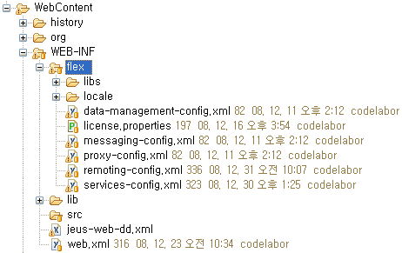
Project Template
Web Content Directory
Remote object configuration file
Spring factory configuration file

